Slide 1
Datta Meghe College of Engineering
(Department of Computer Engineering)
WEBSITE DESIGNER BOT
Internal Guide By
Prof. Madhura Phadke Arvind Gautam
Manish Sinha
Shivam Som

Slide 2

Web development is a broad term for the work involved in developing a website for the Internet. Web design encompasses many different skills and disciplines in the production and maintenance of websites.

Slide 3

Earlier various technologies like HTML/CSS were used to build the website.
It used to take lot of time.
In today’s world, time is money.
Hence it becomes necessary to come up with such a system that will eventually save the time.

Slide 4

Website designer is simply a tool which automatically builds the website for user.
User can select the templates available online and with the help of manual editing it becomes very easy and time saving to accomplish the task.
But what if user is confused about which template to use or doesn’t seem to get what he/she desires?

Slide 5

Users are bored by writing several lines of codes for web pages.
Even drag and drop methods provided by various websites can be tedious.
Many small businesses do not have the budget for a good, custom built website, and also lack the technical know-how to design a website themselves, even with a “What You See Is What You Get (WYSIWYG)” website builder.
So what’s the solution?

Slide 6
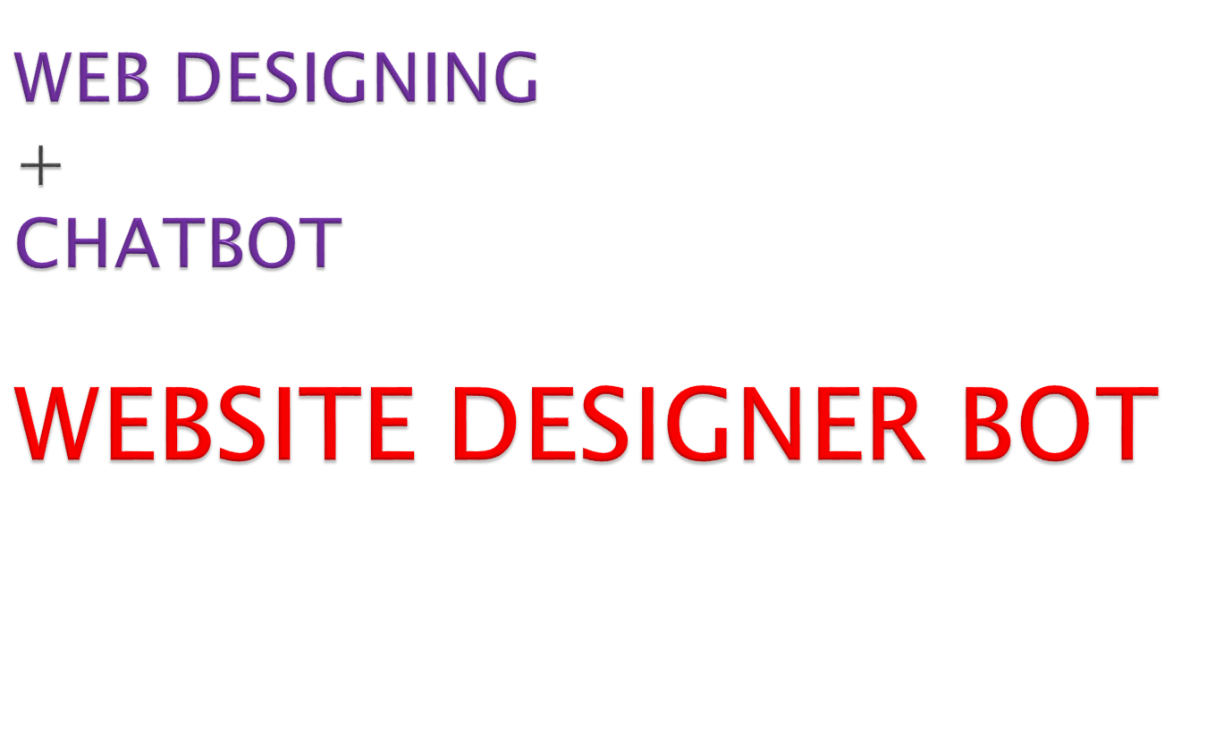

Slide 7

We want to make building websites as simple as chatting over text and answering a few questions.
Using a conversational interface, the bot asks you questions about yourself, your business and your site, then lets you click to see different designs you can customize to meet your needs.
The bot will even prompt you to save your work, as you get further into the site creation process.
Hence the most important part of our system becomes
CHATBOT

Slide 8
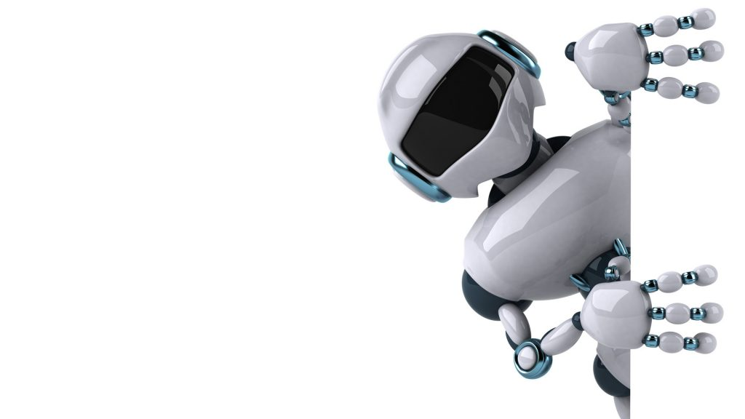


Slide 9

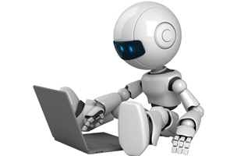
chat robot, a computer program that simulates human conversation, or chat, through artificial intelligence.
Typically, a chatbot will communicate
with a real person.

Slide 10

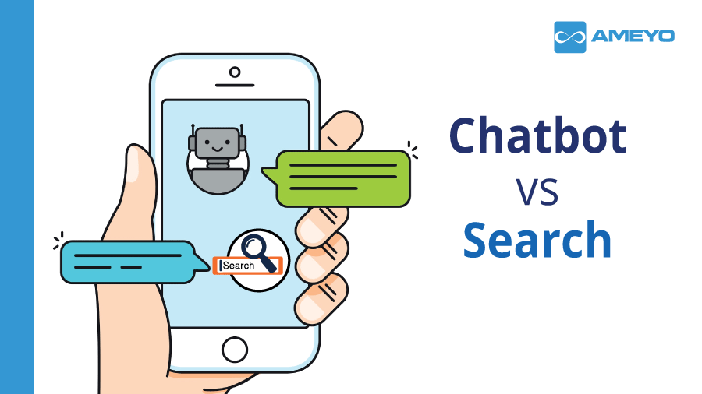
Chotbot is going to really change the approach of user towards website building.
User can easily interact with the chatbot to put his demand regarding his website.
The chatbot will itself recommend the user with best template suiting to his requirement.

Slide 11
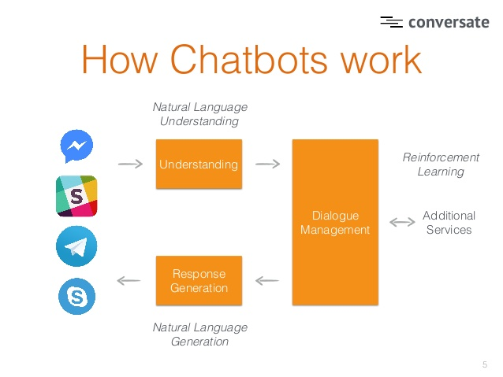

Slide 12

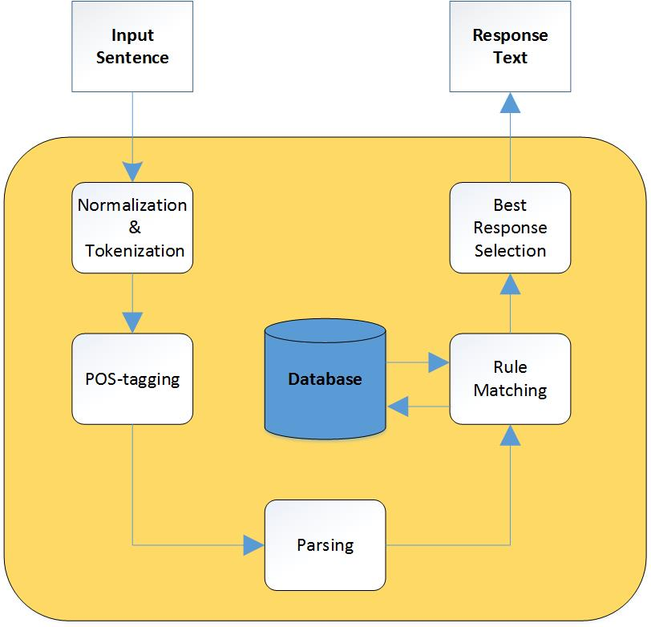

Slide 13

1.Normalization is a process that converts a list of words to a more uniform sequence.
2.Tokenization is the task of chopping it up into pieces, called tokens.
3.A Part-Of-Speech Tagger (POS Tagger) is a piece of software that reads text in some language and assigns parts of speech to each word

Slide 14
4.Parsing is a process of analyzing a sentence by taking each word and determining its structure from its constituent parts.
5.Pattern matching means the interpretations are obtained by matching patterns of words against the input utterance.
6.Response selection basically deals with providing the best available response.
The algorithm which makes bot work efficiently is Natural language Processing(NLP)

Slide 15

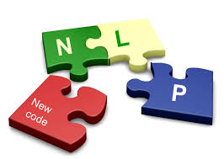
Natural language processing (NLP) is the ability of a computer program to understand human speech as it is spoken.
NLP is a component of artificial intelligence.
It makes computer to perform useful tasks with the natural languages humans use.
Current approaches to NLP are based on machine learning.
The input and output of an NLP system can be −
1.Speech
2.Written text

Slide 16
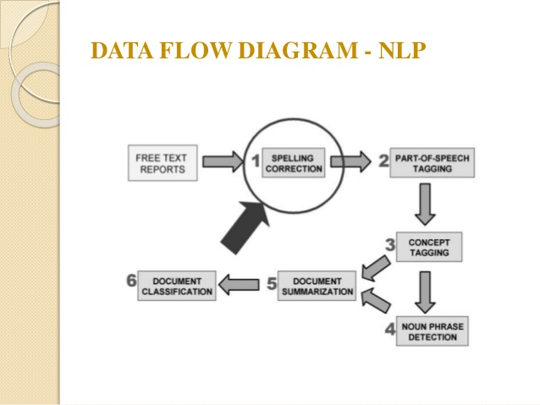

Slide 17

I/P
O/P
GUI
Internal Process
File Sys DB
User
String

Slide 18
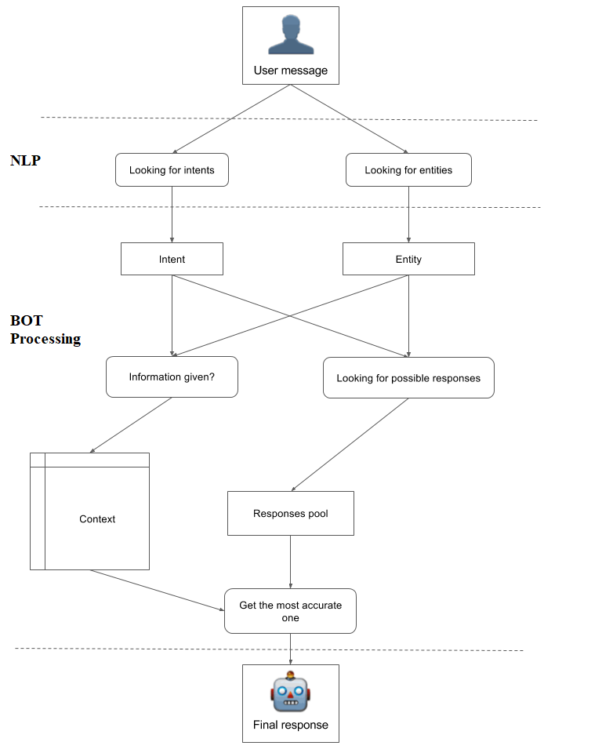
Illustration
Of
Internal
Process

Slide 19

Chatbot
Browser
Hello! How may I help you?
Header Template
I want to build a cooking website
Body Template
Absolutely! I will guide you through the process…
Footer Template
Enter message...

Slide 20
The users can communicate with the chatbot GUI
GUI provides the input to the chatbot where the inner processes of the chatbot begin to process the information using the methods described before in the Process Overview (Normalization, POS Tagging, etc.)
Using NLP and Machine Learning, the bot will try to breakdown the intent of the user and identify the entities using the provided response pool and training set that the bot was trained on.
The best matching response will then be displayed to the user, and the process will continue with respect to to the context of the user. Accordingly, the templates selected by the bot will be displayed in the browser frame. User can then decide according to requirements.

Slide 21

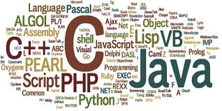
Visual C#
PHP
HTML/CSS
MySQL
LUIS

Slide 22


C# (pronounced "C sharp") is a programming language that is designed for building a variety of applications that run on the .NET Framework
C# is simple, powerful, type-safe, and object-oriented.
Visual C# is an implementation of the C# language by Microsoft. Visual Studio supports Visual C# with a full-featured code editor, compiler, project templates, designers, code wizards, a powerful and easy-to-use debugger, and other tools.
C# will act as the base language for us to develop our system.

Slide 23


PHP is a server-side scripting language designed primarily for web development but also used as a general-purpose programming language.
PHP code may be embedded into HTML or HTML5 mark up, or it can be used in combination with various web template systems, web content management systems and web frameworks.
PHP code is usually processed by a PHP interpreter implemented as a module in the web server or as a Common Gateway Interface (CGI) executable.
PHP will be used to develop and manage the web templates in our project.

Slide 24

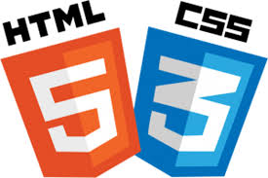
Hypertext Markup Language (HTML) is the standard mark up language for creating web pages and web applications.
With of a document written in a mark up language Cascading Style Sheets (CSS) and JavaScript it forms a triad of cornerstone technologies for the World Wide Web.
Cascading Style Sheets (CSS) is a style sheet language used for describing the presentation.
In our project we will use HTML/CSS to create the templates.

Slide 25


MySQL is an open-source relational database management system (RDBMS).
The MySQL development project has made its source code available under the terms of the GNU General Public License, as well as under a variety of proprietary agreements.
It helps to create and manage database in most efficient manner.
We are using MySQL to mange the database in our project.

Slide 26

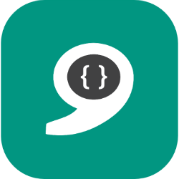
LUIS stands for Language Understanding Intelligent Service.
A LUIS app is a place for a developer to define a custom language model. The output of a LUIS app is a web service with an HTTP endpoint that you reference from your client application to add natural language understanding to it.
Here we are going to use LUIS to develop our chatbot using components like Utterances, Intents and Entities.
LUIS even helps us to train our bot automatically using the Active Learning Feature where un-labeled utterances are automatically suggested to the programmer to label for future use.

Slide 27

We have discussed that usage of website designer bot can simply aid the non technical user to build their own web site.
We highlighted how natural language processing can be used to prepare the website of user choice on the basis of user’s demand or idea.
We have described different tools and technologies that can be used to develop simple website by just communicating with the bot.
We have also shown an approach to build a system using the above shown technologies.

Slide 28


